Slide 1
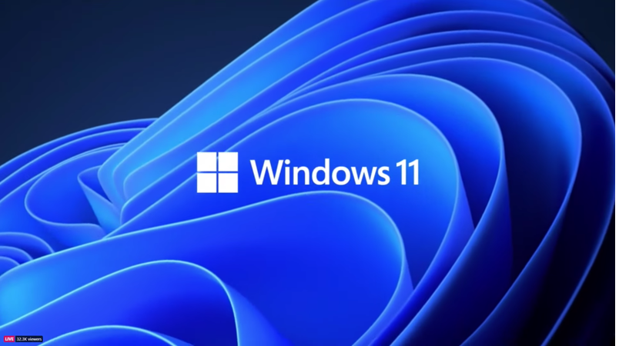
What the New Windows Version Means For Developers

Slide 2
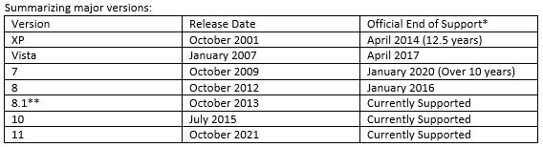
Windows OS Upgrades are Infrequent
Notes:
So far this century, Microsoft has release seven major Windows desktop versions. Windows XP was the most advanced Windows for six years, and activity supported for more than 12. While Windows 8 came out three years after Windows 7, eight was not well received and 7 remained the primary version until Windows 10 appeared in 2015. The original Windows 8 went EOL four years before its’ predecessor.

Slide 3
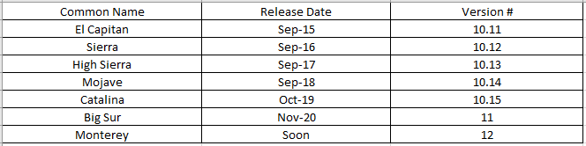
We Have Seen 7 Mac OS Versions Since Windows 10 Release
Notes:
High Sierra will go EOL later this fall, but Apple supports four major versions, with a fifth coming soon. Microsoft supports just three, and counting 8.1, which is not widely used. Active support is typically four years after release for Apple OS versions.

Slide 4
So, what does that mean to us, as developers?
In this class we are developing for the web, meaning that our applications run in the browser, creating a layer between our sites and the operating system. That allows the same version of a website to run on Windows, Linux and Mac, usually without problems.
Java runs on the server, and that will not interact directly with the new desktop OS.
Notes:
Hopefully, this is the last nail in the coffin of Internet Explorer, as it’s limitations are getting more and more troublesome.

Slide 5
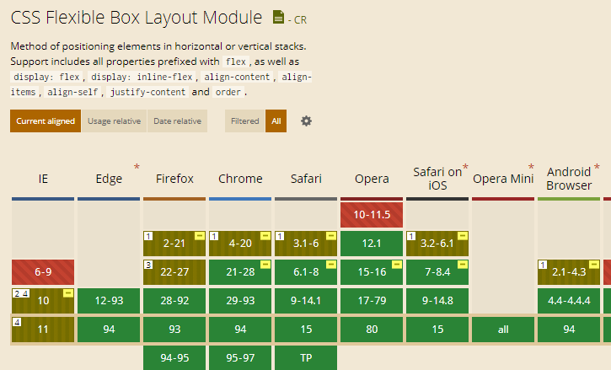
Remember This From Advance CSS?
Notes:
If you’ve had Advanced CSS, you probably remember “Can I Use” tables, indicating if a feature is supported on a specific browser version. To use a feature that was not supported on all current browsers required complicated coding. Microsoft encourages the use of Edge, which supports almost all of the features covered in class. Chrome and Firefox will probably be widely used, but I can hope that users install the newest version of their favorite browser when they update the OS. That will mean more support for popular features. Windows 11 ships without Internet Explorer, and hopefully that’s the last nail in the coffin for that browser. The limitations are quite significant.

Slide 6
If We Work On Desktop Apps, We Will Use the API
Knowing programming languages and processes, we may be working on desktop applications. Those interact with the operating system, and this is done though the Application Programming Interface, or API. We are familiar with the concept when we call System methods like System.out.println. Fortunately, this one works with all current operating systems, but some API calls do not. Typically, desktop applications have different versions for Mac and Windows, and possibly Linux. However, they keep as much of the code base in common as possible.
Notes:
Multi-platform development goals are one of many reasons for modular software design. Only components that interact with the API need to be modified for different operating systems, including new releases.

Slide 7
Basic Windows API Features Will Not Change
Basic Services like system calls, saving files, etc.
Advanced Services such as the Windows Registry, background functionality, and more
Graphic Device Interface – output to monitor, printer, etc.
User Interface – the familiar Windows GUI, with app windows, buttons and the like
Common Dialog Box Library – smaller interfaces to open and save files, choose colors, and other simple interactions
Common Control Library – tool bars, tabs, status bars, and more
Windows Shell – best known as the command line interface.
Network Services – communication with other computers and network devices.
Notes:
The Windows 11 system may make incremental changes to improve performance, and the visual output may be sightly different, but code to open a file or print a stack trace will still work.

Slide 8
Security Sees Progress
According to Microsoft Windows Hardware Developer Documentation:
“Hypervisor-Protected Code Integrity can use hardware technology and virtualization to isolate the Code Integrity (CI) decision-making function from the rest of the Windows operating system. When using virtualization-based security to isolate Code Integrity, the only way kernel memory can become executable is through a Code Integrity verification.”
Using the TPM chip and Secure Boot may also offer protection against rootkits and similar forms of malware that corrupt the boot process. The TPM serves as a “root of trust” that is hard-wired on the motherboard and can’t be changed by code, malicious or otherwise. Using this secure core as a base, Windows can check the in integrity of critical parts of the firmware and operating system.
Only time will tell if this is a turning point in the struggle against malware. At the very least, it will make rootkits and other attacks that corrupt the boot process harder to execute.
It may also help defend against other types of injection, which deliberately enter executable code into what should be ordinary data.
Notes:
A key takeaway here this that whatever security measures designers have developed so far in the computer age, hackers have developed new forms of attack. If they can’t break through a defense (like AES encryption, which has not been cracked at the time of this writing) they try to find ways around it, such as stealing credentials to access the encryption key. The most obvious value of new systems is that criminals don’t know how to break them.
Technology grounded in the TPM may not be breakable directly, but how hard it is to circumvent is not currently known with a new system.

Slide 9
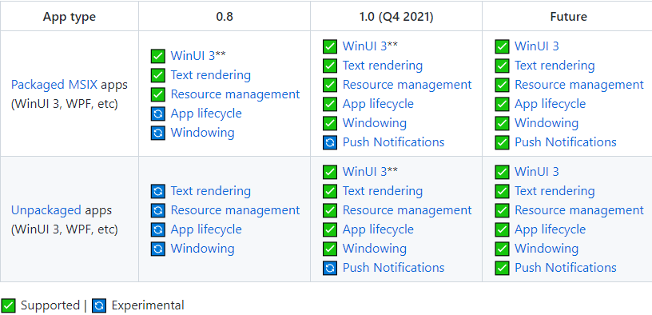
Windows 11 SDK* is on GitHub!
*Software Development Kit
Notes:
An SDK has the tools developers need to code for a specific platform. The SDK for Windows 11 is already on GitHub in a public repository, and I’ve included the link in the PowerPoint document.
There are more new features than I can cover verbally, but this screenshot is from GitHub, which you are free to explore.

Slide 10
The Look and Feel is Smoother
The compositor clock API offers statistics and frame rate control for presenting on-screen content smoothly, at the fastest possible cadence, and on a variety of hardware configurations. Based on some video examples, this smoothness will be a great help to autistic users, reducing fatigue with little configuration or effort.

Slide 11
Sources Used
https://en.wikipedia.org/wiki/Windows_11
https://developer.microsoft.com/en-us/windows/windows-for-developers/
The compositor clock API
https://docs.microsoft.com/en-us/windows-hardware/drivers/bringup/device-guard-and-credential-guard
https://github.com/microsoft/WindowsAppSDK
https://caniuse.com/?search=flexbox

